Slide 1


Slide 2
Pizza sales report
Introduction –
The Pizza Sales SQL Project is designed to analyze pizza sales data using SQL queries and database management techniques. The project focuses on understanding customer ordering patterns, sales performance, and revenue generation. Various SQL concepts such as JOINS, Aggregate Functions, GROUP BY, and Window Functions are used to extract meaningful insights from the data. This analysis helps in identifying best-selling pizzas, peak order timings, and overall business trends, supporting better decision-making for restaurant management.
Database Architecture Summary –
The analysis is executed across four interconnected tables, mapping transactional data directly to product attributes:
orders: Logs core transaction endpoints (order_id, date, time).
order_details: Captures granular line items within each transaction (order_details_id, order_id, pizza_id, quantity).
pizzas: Functions as the product master list tracking pricing metrics (pizza_id, pizza_type_id, size, price).
pizza_types: Stores high-level product metadata and structural grouping (pizza_type_id, name, category, ingredients).

Slide 3
Project Objectives -
Financial Performance Analysis
Calculate Total Revenue and Average Order Value (AOV) to quantify business health.
Analyze the percentage contribution of different pizza categories to overall sales
Operational Efficiency mapping
Identify peak rush hours and high-volume days of the week to optimize staffing.
Determine throughput trends by calculating the average number of pizzas per order.
Menu & Portfolio Optimization
Rank the top 5 and bottom 5 pizza varieties based on revenue and quantity sold.
Evaluate consumer size preferences (S, M, L, XL) to optimize inventory and dough preparation.
Technical SQL Implementation
Execute multi-table Inner Joins across a 4-table relational schema.
Apply Aggregate Functions (SUM, COUNT, AVG) and Window Functions (RANK, OVER) for advanced data insights.

Slide 4
Case Studies –
Retrieve all orders placed on 2015-01-01.
List all distinct pizza categories available.
Find total number of pizzas ordered.
Get the top 5 most frequently ordered pizza types
Show orderid and total pizzas ordered in each order.
Find the number of orders placed in each hour of the day.
Find the day of the week on which the maximum number of orders were placed.
Find the earliest and latest order time for each day.
Find the total revenue generated from each pizza type.
Which pizza category generated the maximum revenue?
Find the average number of pizzas ordered per order.
List the top 3 orders which spent the most
Find the cumulative revenue generated throughout the day (running total).
Identify the pizza that has been ordered the least number of times.
Find the percentage contribution of each pizza category to total revenue.
Find the max Difference(minutes) of each order placed on each day
Find the rolling avg sales of last 3 months
Compare the Previous Month Sales with the current month and show only declining sales.

Slide 5
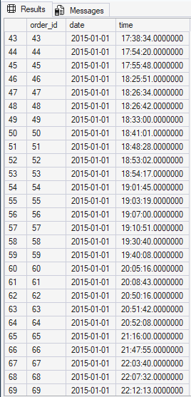
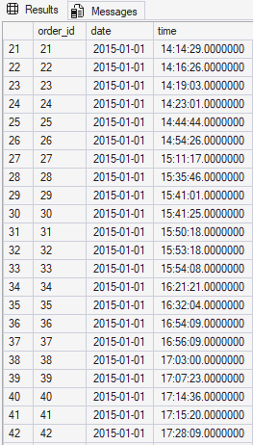
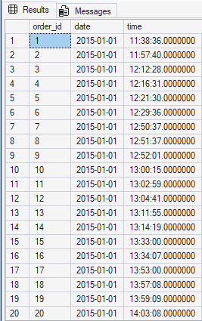
SQL QUERIES
SQL Queries & Analysis
1. Retrieve all orders placed on 2015-01-01.
Query-
select * from orders
where date = '2015-01-01'
Result-

Slide 6
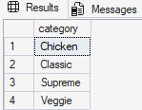

2. List all distinct pizza categories available.
Query -
select distinct(category) from Pizza_Types
Result-
3. Find total number of pizzas ordered.
Query -
select sum(quantity) as total_pizzas from order_details
Result-

Slide 7
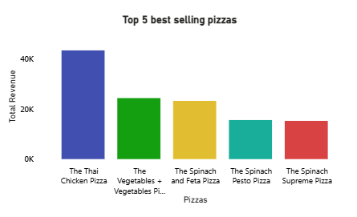
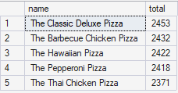
4. Get the top 5 most frequently ordered pizza types.
Query -
select top 5 pt.name, sum(od.quantity) as total from
Pizzas p join order_details od
on p.pizza_id = od.pizza_id join Pizza_Types pt
on p.pizza_type_id = pt.pizza_type_id
group by pt.name
order by total desc
Result -

Slide 8
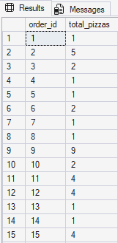
5. Show order_id and total pizzas ordered in each order.
Query -
select order_id , sum(quantity) as total_pizzas from order_details
group by order_id
order by order_id
Result -
Note: The SQL query successfully executed and returned all 21,350 rows (representing the complete annual dataset). For presentation clarity and to save slide space, only the top snapshot of the results table is shown here.

Slide 9
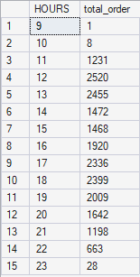
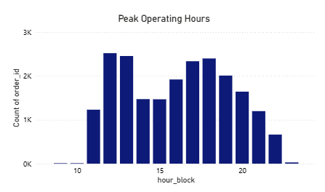
6. Find the number of orders placed in each hour of the day.
Query -
select DATEPART(HOUR,time) HOURS, count(order_id) as total_order from orders
group by DATEPART(HOUR,time)
order by HOURS
Result -

Slide 10
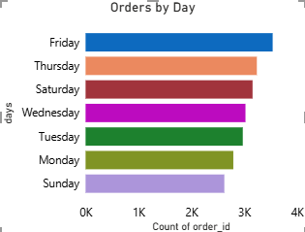

7. Find the day of the week on which the maximum number of orders were placed.
Query -
select top 1 datename(WEEKDAY,date) as day, count(order_id) as no_of_orders from orders
group by datename(WEEKday,date)
order by no_of_orders desc
Result -

Slide 11
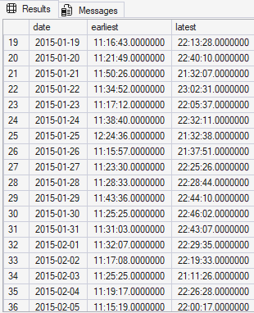


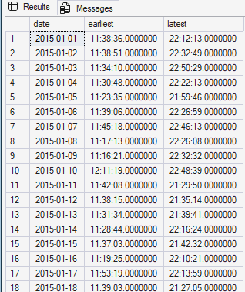
8. Find the earliest and latest order time for each day.
Query -
select date, min(time) as earliest, max(time) as latest from orders
group by date
order by date
Result -
Note: The SQL query successfully processed and generated the complete dataset of 358 rows (representing every operational day of the year). To maintain presentation legibility, the tables above showcase a snapshot of the initial weeks, while the cards highlight the absolute earliest opening and latest closing timestamps found across the entire year

Slide 12
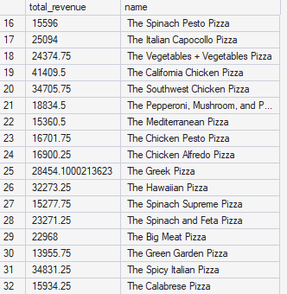
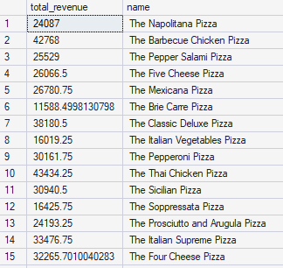
9. Find the total revenue generated from each pizza type.
Query -
select sum(od.quantity*p.price) as total_revenue, pt.name from Pizza_Types pt join Pizzas p on pt.pizza_type_id = p.pizza_type_id
join order_details od on od.pizza_id = p.pizza_id
group by pt.name
Result -

Slide 13

10. Which pizza category generated the maximum revenue?
Query -
select top 1 sum(od.quantity*p.price) as max_revenue, pt.category from Pizza_Types pt join Pizzas p on pt.pizza_type_id = p.pizza_type_id
join order_details od on od.pizza_id = p.pizza_id
group by pt.category
order by max_revenue desc
Result -

Slide 14

11. Find the average number of pizzas ordered per order.
Query -
with cte as (
select order_id, SUM(quantity) as total_pizza
from order_details
group by order_id)
select avg(total_pizza) as avg_pizzas_per_order
from cte
Result -

Slide 15
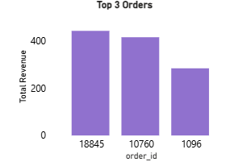
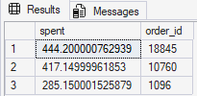
12.List the top 3 orders which spent the most.
Query -
select Top 3 SUM(od.quantity * p.price) as spent , od.order_id from order_details od join Pizzas p
on od.pizza_id = p.pizza_id
group by order_id
order by spent desc
Result -

Slide 16
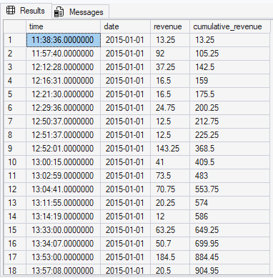
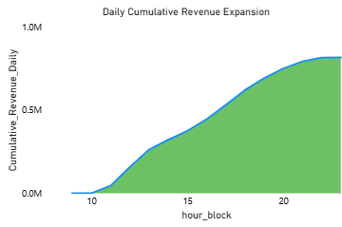
13. Find the cumulative revenue generated throughout the day (running total).
Query -
select o.time, o.date, round(sum(quantity*price),2) as revenue ,
sum(round(sum(quantity*price),2)) over( partition by o.date order by o.time) as cumulative_revenue
from orders o join order_details od on o.order_id = od.order_id join Pizzas p on od.pizza_id = p.pizza_id
group by o.date, o.time
Result -
Note: The SQL query executed successfully and compiled all 21,350 unique order rows across the entire database. To maintain presentation readability and save slide space, only a high-level snapshot of the results grid is shown above.

Slide 17

14. Identify the pizza that has been ordered the least number of times.
Query -
select TOP 1 pt.name as name ,sum(quantity) qty from Pizza_Types pt join Pizzas p
on pt.pizza_type_id = p.pizza_type_id join order_details od
on od.pizza_id = p.pizza_id
group by pt.name
order by qty
Result -

Slide 18
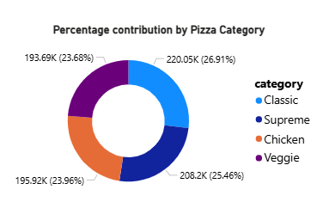
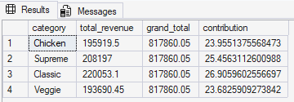
15. Find the percentage contribution of each pizza category to total revenue.
Query -
select pt.category , round(sum(quantity*price),2) as total_revenue,
sum(round(sum(quantity*price),2)) over() as grand_total,
round(sum(quantity*price),2)*100/sum(round(sum(quantiy*price),2)) over() as contribution
from Pizza_Types pt join Pizzas p
on pt.pizza_type_id = p.pizza_type_id join order_details od
on od.pizza_id = p.pizza_id
group by pt.category
Result -

Slide 19
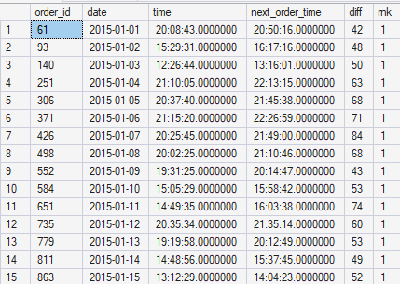
16. Find the max Difference(minutes) of each order placed on each day
Query -
with cte as (select *,
lead(time) over (partition by date order by time) as next_order_time, datediff(minute, time, lead(time) over (partition by date order by time)) as diff from orders),
cte2 as (select *,dense_rank() over (partition by date order by diff desc) as rnk from cte)
select * from cte2
where rnk = 1
Result -
NOTE: Total rows calculated: 364. To maintain presentation legibility and keep the slide uncluttered, the table displays a targeted 15-day snapshot illustrating the query's precision tracking.

Slide 20
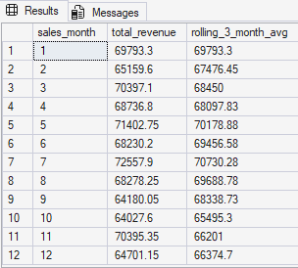
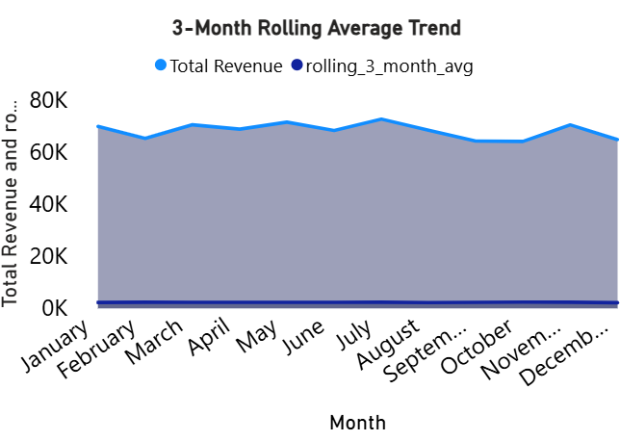
17.find the rolling avg sales of last 3 months
QUERY -
with cte as (select datepart(month, o.date) as sales_month,
round(sum(od.quantity * p.price),2) as total_revenue
from orders o join order_details od on o.order_id = od.order_id
join pizzas p on od.pizza_id = p.pizza_id
group by datepart(month, o.date))
select sales_month,total_revenue,round(avg(total_revenue)
over ( order by sales_month
rows between 2 preceding and current row),2) as rolling_3_month_avg
from cte
RESULT -

Slide 21
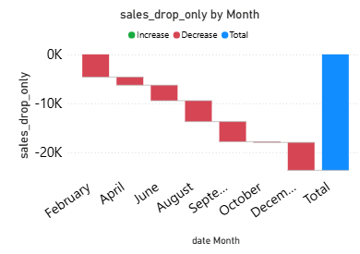
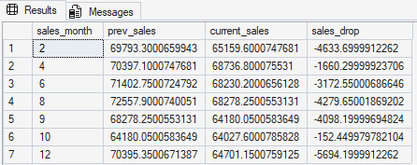
18.Compare the Previous Month Sales with the current month and show only declinig sales.
QUERY -
with cte as (
select datepart(month, o.date) as sales_month,sum(od.quantity * p.price) as current_sales
from orders o join order_details od on o.order_id = od.order_id
join pizzas p on od.pizza_id = p.pizza_id
group by month(o.date)),
cte2 as (select sales_month, current_sales,
lag(current_sales) over (order by sales_month) as prev_sales from cte)
select sales_month,prev_sales,current_sales,(current_sales - prev_sales) as sales_drop from cte2
where current_sales < prev_sales
RESULT -

Slide 22
Conclusion and key insights
Sales Analysis
Identified the most ordered pizzas and top-performing categories.
Calculated total pizzas sold and overall revenue generation.
Customer Ordering Trends
Analyzed peak ordering hours and busiest weekdays.
Studied customer purchasing behavior and ordering patterns.
Revenue Insights
Determined highest revenue-generating pizza categories.
Calculated category-wise revenue contribution and running revenue totals.
SQL Implementation
Applied JOINS, Aggregate Functions, and Window Functions for advanced analysis.
Generated meaningful business insights using SQL queries.

